Slide 1
Infographic Agentic AI Foundations
Core principles driving autonomous artificial intelligence systems
Notes:
---

Slide 2
Agentic AI Concepts
Notes:
Core Characteristics of Agentic AI, Design Motivation for Agentic Systems, Agentic AI Operating Cycle

Slide 3

Design Motivation for Agentic Systems
Modular Task Decomposition
  Agentic AI breaks complex tasks into independent modular components for efficient parallel processing and easy substitutions.
Distributed Autonomous Decision-Making
  Autonomous agents distribute decision-making to reduce bottlenecks and increase throughput across workflows.
Adaptive Learning and Feedback
  Agentic systems learn from feedback loops to improve robustness and adapt to real-world uncertainties.
Strategic Human-AI Collaboration
  Agentic AI automates repetitive data tasks, enabling humans to focus on oversight and creative decision-making.
Notes:
The rise of agentic architectures is driven by the need for scalable, adaptive, and highly automated systems capable of handling tasks that exceed the constraints of traditional deterministic workflows. Organizations increasingly require systems that can perform parallel operations, such as running multiple web searches, interrogating structured and unstructured datasets, or orchestrating multi‑tool pipelines. Agentic AI enables such capabilities by decomposing tasks into modular components that can run independently or cooperatively. This modularity not only accelerates task execution but also makes it easier to substitute individual components—such as search tools, analytical models, or evaluators—without rewriting entire systems. By distributing decision‑making across autonomous agents, enterprises can reduce bottlenecks caused by human oversight and achieve higher throughput. Additionally, agentic systems can learn from feedback loops, making them more robust to errors and more adaptable to real‑world uncertainty. For example, logistic networks benefit from agents capable of recalibrating routes in real time, while financial institutions use decision‑making agents to analyze irregularities before escalating anomalies. The strategic value lies in enabling human teams to focus on oversight and creativity while delegating repetitive, data‑intensive, or time‑sensitive tasks to autonomous digital workers. Agentic AI thus addresses the growing demand for efficient workflow automation and intelligent delegation, offering capabilities that complement and extend traditional AI systems.

Slide 4
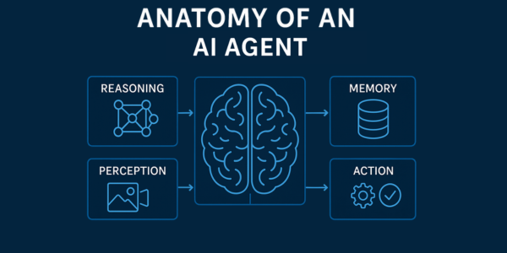
Agentic AI Operating Cycle
Perception Stage
  Agents gather information from diverse sources like APIs, sensors, documents, and web data to understand the environment.
Reasoning Stage
  The agent processes gathered data using inference models to understand context and generate insights.
Planning Stage
  High-level goals are broken into actionable steps involving tool selection and coordination with other agents.
Action and Reflection
  Agents execute plans via tools and systems, then evaluate outcomes to refine future strategies.
Notes:
The agentic operating cycle represents a continuously evolving loop that allows intelligent agents to improve performance over time. The cycle begins with perception, where agents gather information from diverse inputs such as APIs, sensors, documents, or web sources. In the reasoning stage, the agent processes this information using an LLM or other inference models to understand context, identify goals, and generate intermediate insights. Planning is the subsequent stage, where the agent breaks high‑level objectives into structured, actionable steps that may involve selecting tools, querying data sources, or coordinating with other agents. During the action phase, the agent executes the planned tasks by interacting with software tools, databases, or external systems. Finally, the reflection phase involves evaluating outcomes, comparing results to the intended goals, identifying errors, and refining future strategies. This feedback‑driven adaptation is crucial for improving long‑term effectiveness. For example, an invoice‑processing agent might detect misclassification errors and adjust extraction parameters automatically. The cycle increases reliability and autonomy, making agentic systems superior in environments requiring iterative decision‑making. By iterating through this loop efficiently, agentic AI gains the ability to manage uncertainty, optimize behaviors, and achieve consistent task success.

Slide 5
Agentic AI Implementation Patterns
Notes:
Best Practices for Robust Deployment, Agentic Patterns and Collaboration Models

Slide 6
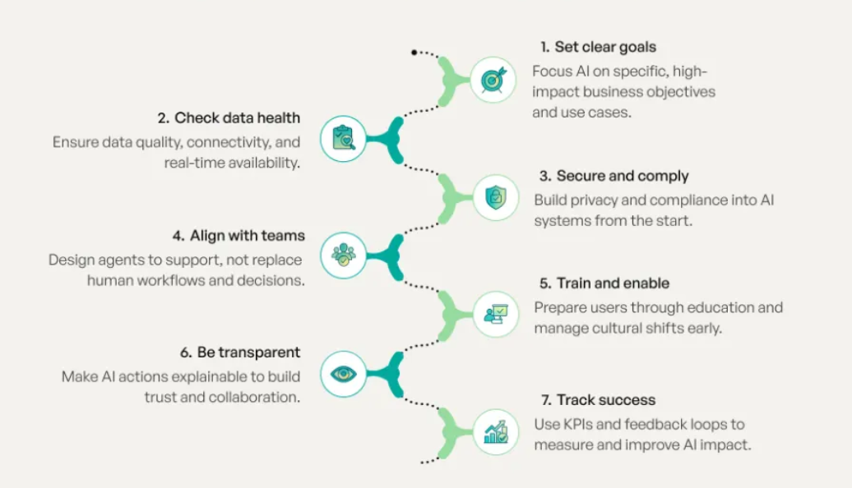
Best Practices for Robust Deployment
Clear Objectives and Quality Data
  Define specific tasks and success metrics while using high-quality datasets for accurate AI decision-making.
Ethical and Security Practices
  Mitigate biases and implement encryption, access control, and audit trails to protect AI systems securely.
Explainability and Integration
  Use explainability tools for transparency and ensure smooth integration with existing IT infrastructure.
Continuous Monitoring and Evaluation
  Regularly monitor AI to detect performance drift, emerging biases, and integrity threats for trustworthiness.
Notes:
Deploying agentic AI systems requires adherence to structured best practices that ensure reliability, fairness, and long‑term maintainability. Clear objectives form the foundation, as organizations must specify the tasks agents will manage and how success is measured. High‑quality datasets further enable agents to make accurate decisions, especially in scenarios requiring context‑aware reasoning. Ethical considerations such as identifying and mitigating biases ensure that automated decisions do not reinforce harmful patterns; for instance, loan‑approval agents must avoid discriminatory behavior. Security practices—including encryption, access control, and audit trails—help protect agent systems from adversarial interference. Explainability techniques like SHAP or LIME improve transparency by allowing teams to interpret why an agent produced a specific output, making debugging more effective. Integrating agentic systems with existing IT environments requires evaluating infrastructure readiness, data formats, and interoperability constraints. Continuous monitoring and evaluation help detect performance drift, emerging biases, or integrity threats. Together, these practices ensure that agentic AI deployments remain trustworthy, scalable, and aligned with business objectives.

Slide 7
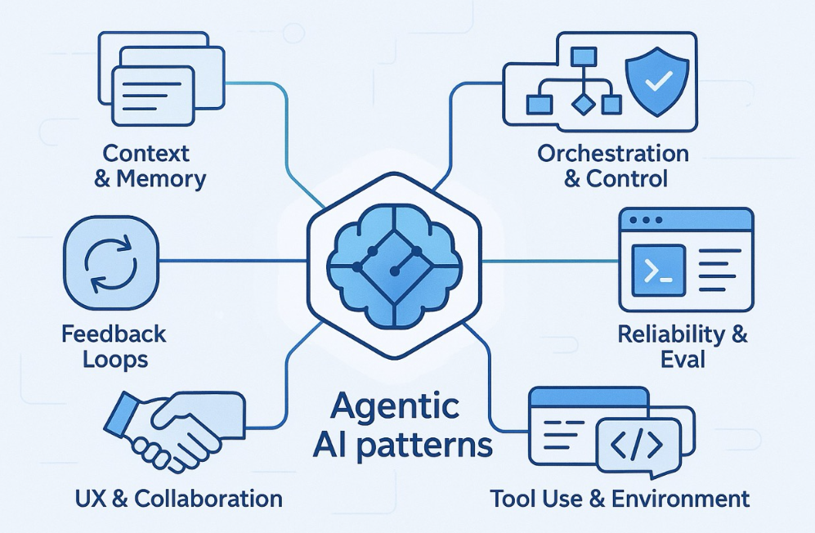
Agentic Patterns and Collaboration Models
Reflection-Driven Agents
  Agents use self-evaluation to iteratively refine strategies, enhancing performance over time.
Tool-Using Agents
  These agents extend reasoning by leveraging external tools like search APIs and computational modules.
Planning-Based Agents
  Break down complex tasks into multi-step sequences, enabling structured task orchestration.
Multi-Agent Collaboration
  Multiple autonomous agents collaborate, share insights, and divide responsibilities for better outcomes.
Notes:
Agentic AI follows recognizable architectural patterns that enable powerful automation. Reflection‑driven agents incorporate self‑evaluation mechanisms to iteratively improve their strategy, while tool‑using agents rely on external capabilities—such as search APIs, data extractors, or computational modules—to extend their reasoning. Planning‑based agents break complex tasks into actionable sequences, enabling multi‑step orchestration such as research aggregation followed by summarization and analysis. Multi‑agent collaboration represents another key pattern where autonomous agents work in parallel or in sequence, sharing insights or dividing responsibilities. Such collaboration unlocks sophisticated workflows—for example, a research agent gathers information, an analysis agent synthesizes it, and a critique agent evaluates the result. This modular teamwork produces results surpassing single‑agent performance. Organizations can design agent networks that dynamically scale, allocate roles, and respond to specialized tasks. This flexibility allows industries to build agent ecosystems that mirror human team structures but with far greater speed, consistency, and task endurance.

Slide 8
Agentic Workflows and Tool Integration
Notes:
Example Workflow: Invoice Processing, Evaluation Framework for Agentic Systems

Slide 9

Example Workflow: Invoice Processing
Invoice Reception Formats
  Invoices are received in formats like PDF, email, and scanned images, enabling flexible and efficient processing. This ensures compatibility with diverse submission methods used by vendors.
  Data Extraction Using OCR
  Optical character recognition extracts key invoice details, such as vendor names and line items, with precision. Advanced OCR tools minimize errors and improve data accuracy during extraction
  Validation and Verification
  Validation ensures accuracy by matching vendor details, checking for duplicates, and verifying invoice totals. It also enforces compliance with predefined business rules and policies.
Automated Processing and Archiving
  Validated invoices are routed for approval and securely archived to meet audit and compliance requirements. Automation reduces manual intervention, speeding up the overall invoice lifecycle.
Notes:
An invoice processing workflow provides a practical example of how agentic AI decomposes and automates tasks in a structured pipeline. The process begins with receiving the invoice file, which may arrive in formats like PDF, email, or scanned imagery. The extraction phase involves optical character recognition (OCR) or structured data extraction tools that pull key fields such as vendor name, invoice number, and line items. Validation steps follow, ensuring extracted values comply with internal rules like vendor matching, duplicate detection, and total‑amount verification. Processing involves routing the validated invoice into accounting systems for approval, payment scheduling, or reconciliation. Finally, the archiving phase stores the document and metadata for audit, compliance, or analytic purposes. In an agentic workflow, each stage is handled by specialized tools orchestrated through autonomous planning: a perception module for OCR, a reasoning component for validation logic, and an execution module for system integration. This modular breakdown allows parallelization—multiple invoices can be processed simultaneously—and enables agents to detect anomalies and trigger corrective actions. Such a workflow illustrates how agentic AI enhances speed, accuracy, and transparency across routine business operations.

Slide 10

Evaluation Framework for Agentic Systems
Comprehensive Testing Pipelines
  Testing simulates diverse real-world scenarios including edge cases and failure modes to ensure AI reliability.
Error Analysis and Refinement
  Error analysis detects issues like reasoning mistakes and misinterpretations to improve model prompts and planning.
Performance Monitoring Metrics
  Monitoring tracks task success, accuracy, latency, and tool usage to optimize AI execution paths effectively.
Human-in-the-Loop and Long-Term Evaluation
  Human oversight ensures safety in sensitive tasks, while long-term evaluation detects performance drift over time.
Notes:
A robust evaluation framework ensures that agentic AI systems operate reliably and safely in real‑world conditions. The framework begins with comprehensive testing pipelines that simulate diverse scenarios, including edge cases and failure modes. Error analysis routines identify recurring issues such as reasoning mistakes, misinterpretations of prompts, or failed tool invocations. These insights enable developers to refine model prompts, adjust planning logic, or enhance tool integration. Performance monitoring tracks key metrics including task success rates, response accuracy, latency, and tool‑usage efficiency. For instance, monitoring whether an agent chooses the optimal tool or unnecessarily repeats steps helps optimize execution paths. Additionally, evaluation frameworks may incorporate human‑in‑the‑loop checkpoints for sensitive tasks, such as medical advice or financial assessments, ensuring agents escalate appropriately. Long‑term evaluation further examines how models behave over extended deployments, helping detect performance drift or degraded accuracy due to changes in data distribution. By applying structured evaluation, organizations maintain high standards of safety, reliability, and user trust in agentic AI.

Slide 11
Interoperability and Protocols
Notes:
Tool Integration via MCP

Slide 12

Tool Integration via MCP
Standardized Interface
  MCP offers a universal interface enabling AI agents to connect effortlessly with diverse tools and services.
Architectural Separation
  Decoupling reasoning logic from tool execution simplifies system design and enhances modularity.
Improved Interoperability
  MCP connectors enable easy swapping of tools without modifying AI agent core logic, improving flexibility.
Scalable Multi-Agent Ecosystems
  MCP supports multi-agent communication and tool chaining, fostering scalable and future-proof systems.
Notes:
The Model Context Protocol (MCP) provides a standardized interface that allows agentic AI systems to interact seamlessly with tools, data sources, and software services. By decoupling an agent's reasoning logic from tool execution, MCP creates a clean architectural separation that simplifies system design. MCP connectors act like universal adapters, enabling agents to plug into databases, search engines, analytics pipelines, or third‑party APIs without requiring custom integrations for each new tool. This improves interoperability and encourages modular system evolution. For example, swapping an older search engine with a more efficient one requires only updating the MCP connector rather than modifying the agent's core reasoning loop. MCP’s structured communication channels allow agents to query tools, receive structured responses, and manage multi‑step operations with consistent formatting. As organizations shift toward multi‑agent ecosystems, MCP helps maintain compatibility across tools and models, reducing integration friction. Ultimately, MCP enables scalable, future‑proof agentic systems by providing the connectivity backbone that supports orchestrated tasks, tool chaining, and inter‑agent communication.

